Slide 1

Airline Management System
G4
Sprint 1
Supervisor : Dr. VGTN Vidanagama
Group Members : M Rimaz (CSE22087) | Ihshan Ahamed (CSE23345) | M Mufees (CSE23318) | M Fayaz (CSE23308)

Slide 2
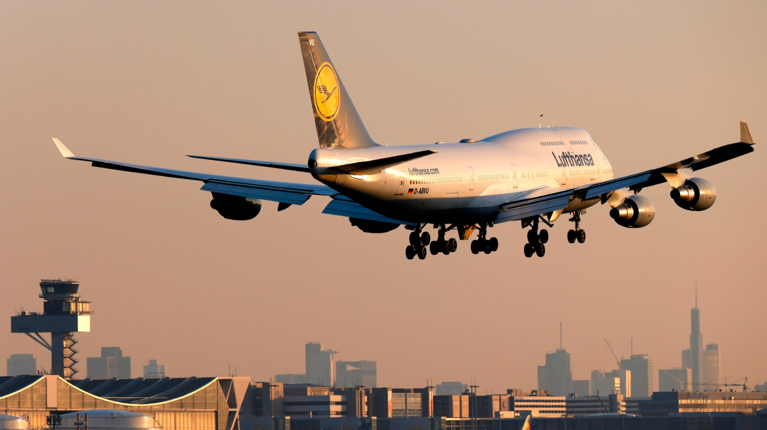
Flight Management System
A Flight Management System is a comprehensive software used in aviation to streamline and optimize various aspects of flight operations, including flight planning, navigation, communication, and data management

Slide 3
Desktop Module Software for Company based Java System
This desktop module is a Java-based software designed for company operations, offering a user-friendly interface and efficient functionalities to enhance administrative and operational tasks.

Slide 4


Module Specifications
The airline reservation system has two main modules like Flight Scheduling, and ticket booking which will be handled by two major Parties (Admin, and Staff) of the application.
Admin
Staff

Slide 5
Admin Features
Separate login page only accessible by Admin
Add , Deletion / Removal of Staff Members
Admin page has the full authority for the system
Admin

Slide 6
Staff Features
Flight scheduling
Customer registration
Tickets booking
Tickets cancellation
Staff

Slide 7

Sprint 1
G4
GROUP 4
AIRLINE MANAGEMENT SYSTEM

Slide 8
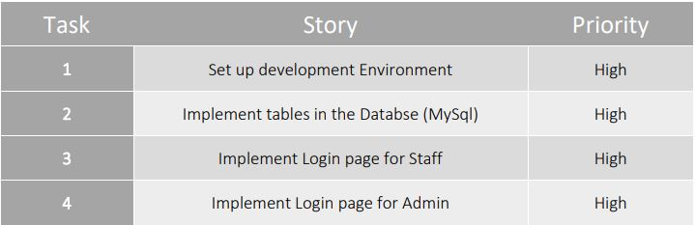
Sprint 1 Backlog

Slide 9
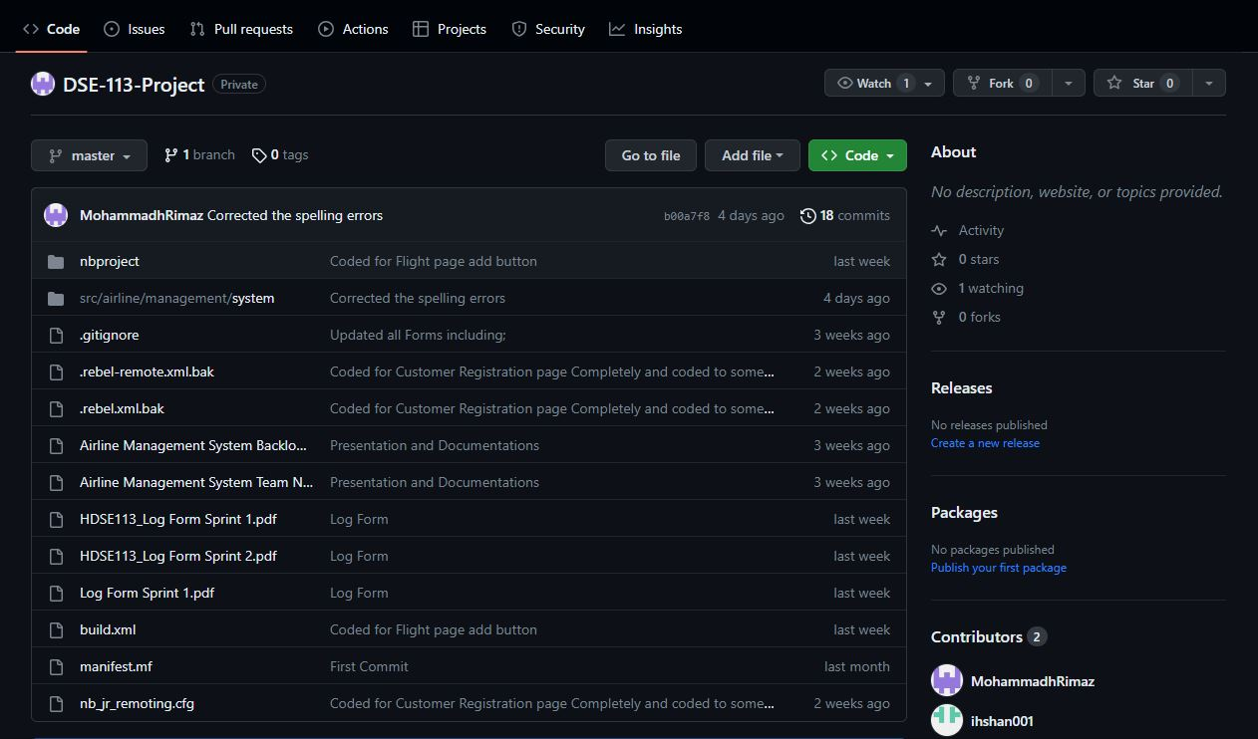
GitHub Task 1

Slide 10
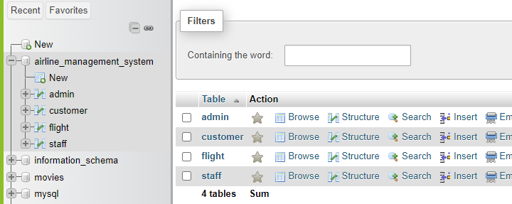
Task 2 Implement table in DB

Slide 11
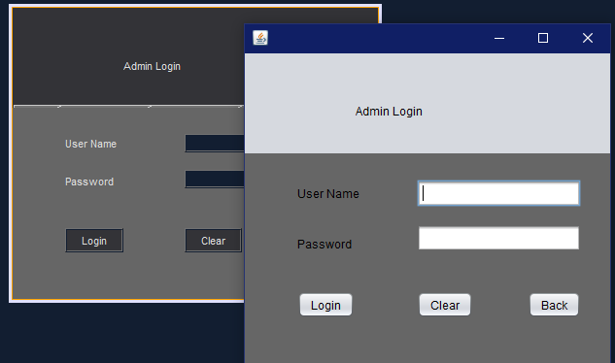
Task 3 Admin Page

Slide 12
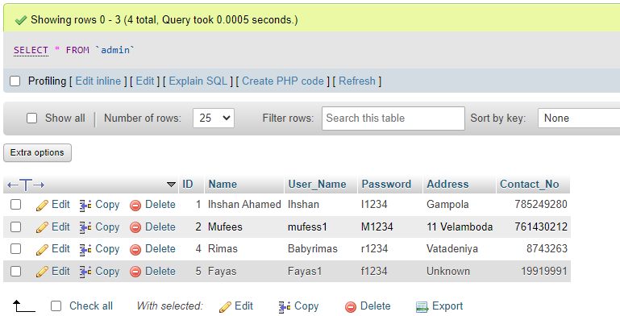
Task 3 Admin Database

Slide 13
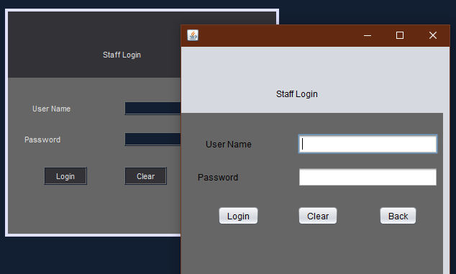
Task 4 Staff Page

Slide 14
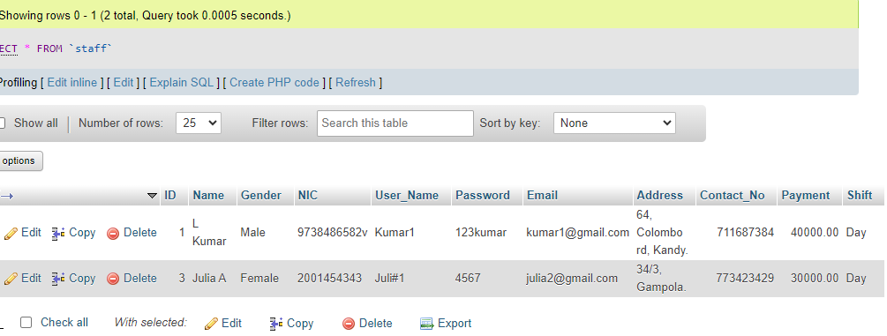
Task 4 Staff Database

Slide 15
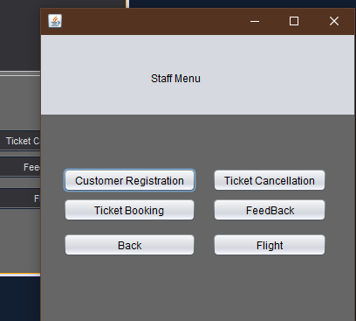
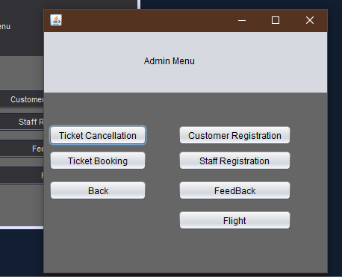
Extras Main Page

Slide 16
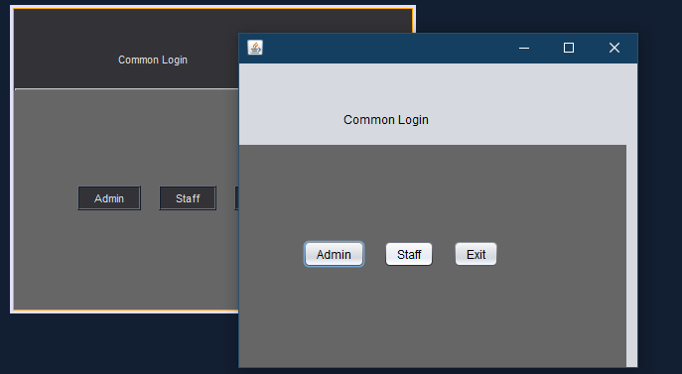
Extras Common Login Page

Slide 17
Sprint 2
G4
GROUP 4
AIRLINE MANAGEMENT SYSTEM

Slide 18
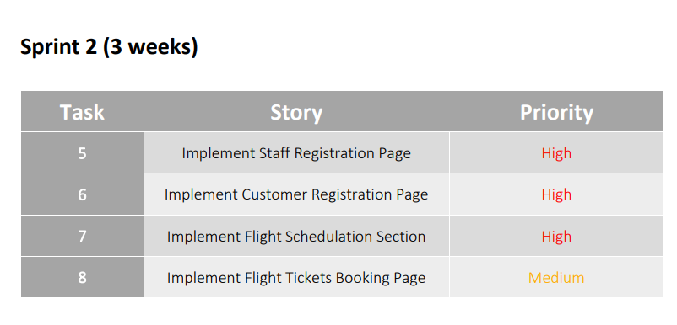
Features
Staff Registration
Customer Registration
Flight Scheduling
Ticket Booking

Slide 19
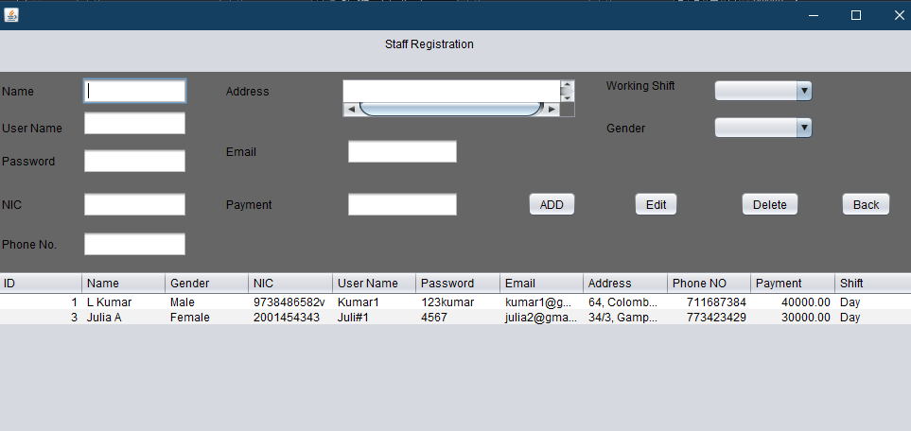
Task 5 Staff Registration

Slide 20
Task 5 Staff Registration Db

Slide 21
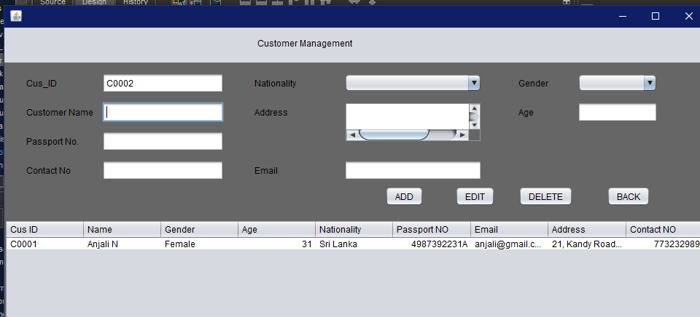
Task 6 Customer Registration

Slide 22
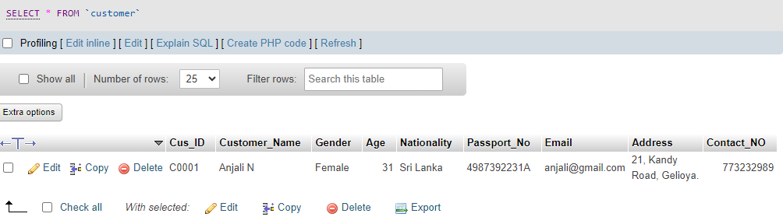
Task 6 Customer Registration Db

Slide 23
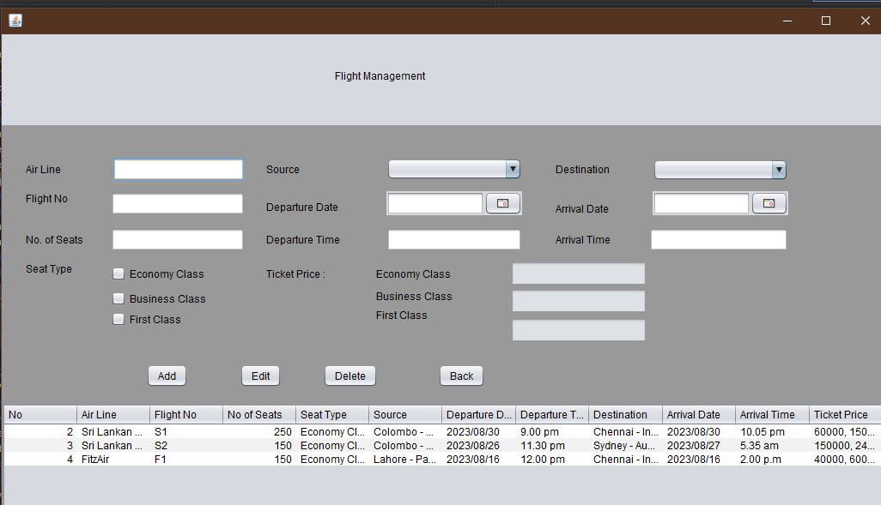
Task 7 Flight Schedule Page

Slide 24
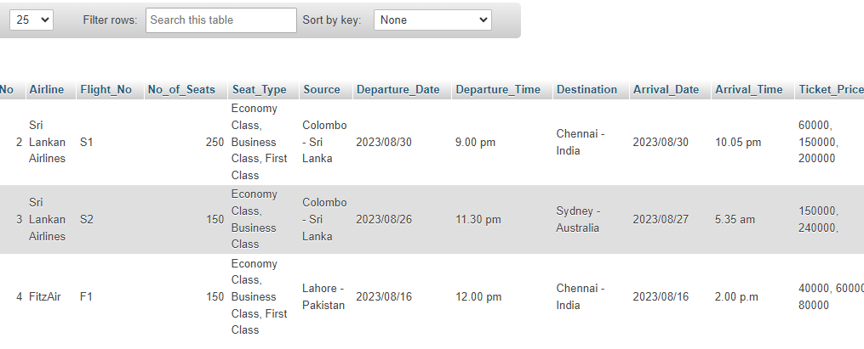
Task 7 Flight Schedule Db

Slide 25
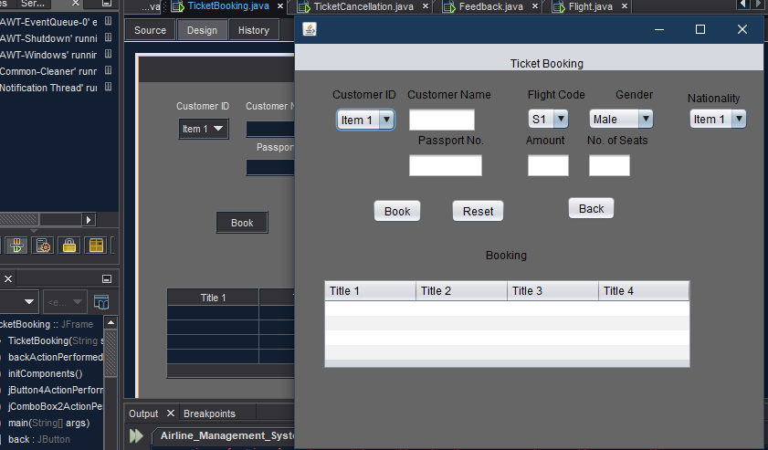
Task 8 Flight Ticket Booking Page

Slide 26
Tasks yet to be Completed
Completed tasks for Sprint 2
Created Staff Registration Page and Updated to the Database
Created Customer Registration page and updated it to the Database
Created Flight Schedule Section and updated to the Database.
Update Flight Booking Section
Create a Ticket Cancellation menu
Create Payment Method
Update all the records to the database
Update Feedback Section
The designing Part will be completed at the End of the Project

Slide 27
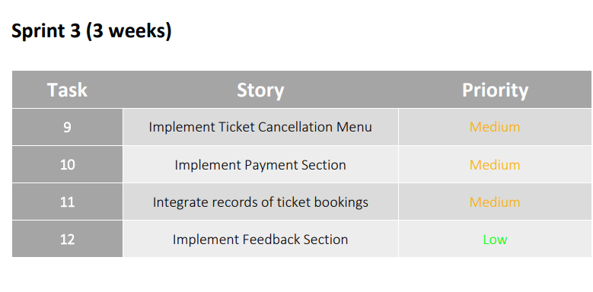
Sprint 3

Slide 28

Thank You For All Your Time & Attention.

